Slide 1
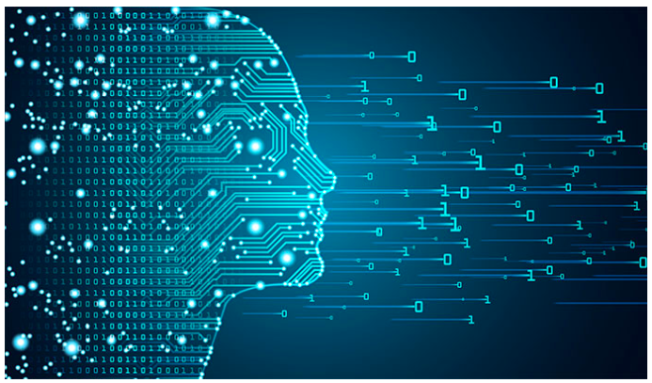
Deep Learning
Dee
Session -7: CNN

Slide 2
MLP/ Dense Network

Slide 3
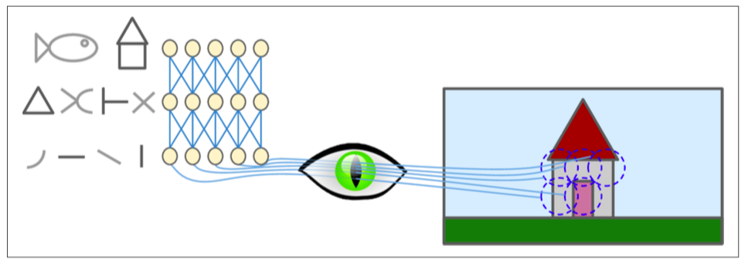
Visual cortex

Slide 4
Convolutional Neural Network

Slide 5
Concept of filter

Slide 6
Convolution ?

Slide 7
Layers in CNN
Input layer
Convolution layer
Pooling layer
Flatten layer
Dense /Output layers

Slide 8
https://poloclub.github.io/cnn-explainer/

Slide 9
Input layer
Input image shape =(height, width, depth/channels); channels = 3, for RGB and =1 for gray scale images.

Slide 10
Convolution layer
Input: (h, w, c)
Kernel
Product of output of earlier layer and kernel
Output: (h,w,c), c is controlled by first argument given in the layer.
Convolution vs densely connected layer: Learning local vs global patterns.

Slide 11
Feature map
Feature map: Is a response to each of the filters.
(height, width, depth) => depth is the no of filters/features.
Convolution is defined by two parameters:
No of filters, Filter size.

Slide 12
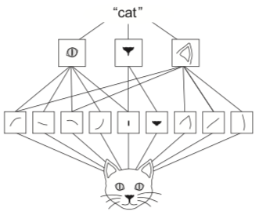
Importance of Convolution
Patterns they learn are translation invariant
Learn spatial hierarchies

Slide 13
Pooling layer
Consolidates
Different types of pooling:
Max Pool
Average Pool

Slide 14
??

